Slide 1
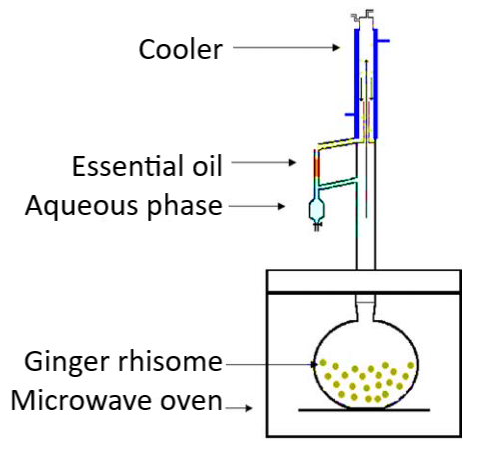
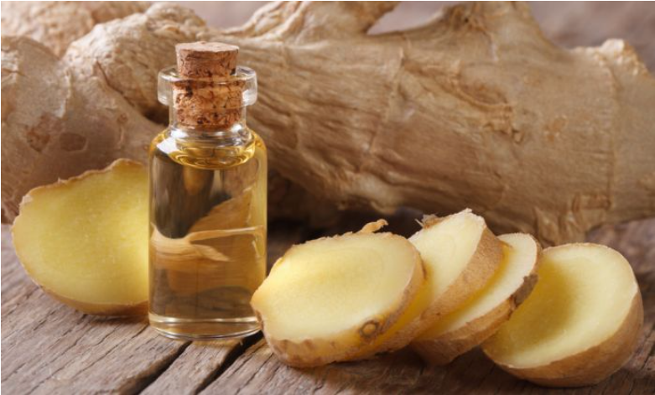
MICROWAVE-ASSISTED EXTRACTION OF ESSENTIAL OIL FROM GINGER (ZINGIBER OFFICINALE ROSC.)
Zorica N. Drinić¹, Miloš S. Jovanović¹, Dejan S. Pljevljakušić¹, Dubravka J. Bigović¹, Katarina P. Šavikin¹
¹Institute for Medicinal Plants Research “Dr. Josif Pančić”, Tadeuša Košćuška 1, 11000 Belgrade, Serbia
Introduction
Results and Discussion
Ginger rhizomes (Zingiber officinale Rosc., Zingiberaceae) are widely used as a popular spice, for food and beverages flavoring and as a medicinal raw material. The unique fragrance of ginger comes from essential oil. Traditional hydrodistillation of essential oils should be replaced by innovative environmentally friendly techniques due to its shortcomings (high energy and time consumption, increased risk of hydrolysis and thermal degradation for essential oil ingredients).
The aim of this study was to compare conventional hydrodistillation and microwave-assisted hydrodistillation at different power levels in terms of qualitative and quantitative composition of ginger essential oil, energy and time requirements, and environmental impact.
Microwave-assisted hydrodistillation achieved a higher extraction yield (1.70, 1.70, and 1.85% for power levels of 180, 360, and 600 W, respectively) compared to hydrodistillation (1.50%).
The essential oil obtained by hydrodistillation contained 43 different compounds, while the essential oils obtained by microwave-assisted hydrodistillation at 180, 360, and 600 W contained 57, 58, and 51 compounds, respectively.
The dominant compound in all samples was α-zingiberene followed by camphene, β-phellandrene, 1,8-cineole, neral, geranial, ar-curcumene, germacrene D, β-bisabolene, and β-sesquiphellandrene.
The content of α-zingiberene in essential oils obtained by microwave-assisted hydrodistillation (34.12, 34.43, and 42% at 180, 360, and 600 W, respectively) was significant higher compared to essential oil obtained by hydrodistillation (29.89%).
Distillation time and energy consumption were reduced by microwave-assisted hydrodistillation (37, 32, 27 min and 0.11, 0.19, 0.27 kWh for power levels of 180, 360 and 600 W, respectively, compared to 144 min and 1.44 kWh for conventional hydrodistillation).
Material and Methods
Conventional hydrodistillation and microwave-assisted hydrodistillation were applied for the isolation of essential oils from dried and powdered ginger rhizomes purchased at a local store.
Microwave-assisted hydrodistillation was performed on three different power levels (180, 360, and 600 W) until no more essential oil was obtained (ca. 20 min).
The chemical composition of the essential oils was analyzed using GC/MS technique. Concerning environmental impact, electrical consumption and carbon dioxide emission were calculated.
Conclusion
Therefore, microwave-assisted hydrodistillation is an applicable technique for the isolation of ginger essential oil that improves yield, reduces time and energy requirements, while maintaining oil quality.
Acknowledgement: Ministry of Education, Science and Technological Development of Republic of Serbia, contract number 451-03-68/2020-14/200003.

